Slide 1



B.Bhuvaneswaran, AP (SG)/CSE, REC

Slide 2


Slide 3
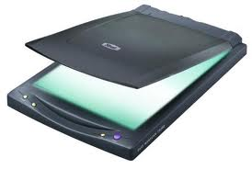
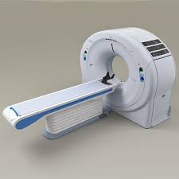
A Java Class
Scanner

Slide 4

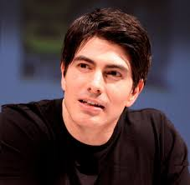
A Java Keyword
Super

Slide 5
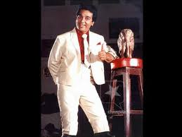
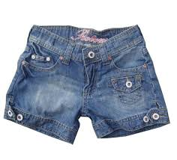
Data Type
Short

Slide 6


Access Specifier
Public

Slide 7
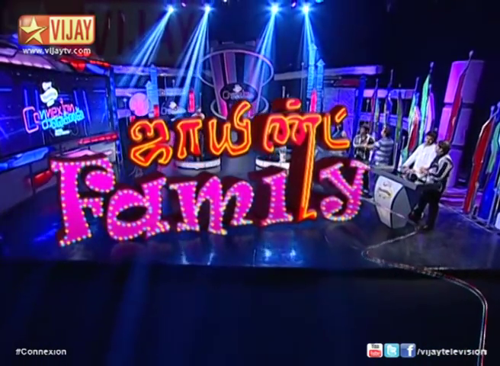

Slide 8

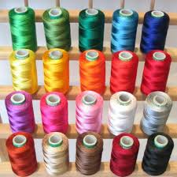
A Java Feature
Multithreaded

Slide 9



Another Way to Pass Values
Command Line Argument

Slide 10


A Java Technology
Package

Slide 11

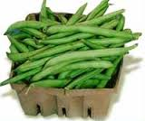
A Java IDE
Netbeans

Slide 12


A Java IDE
Eclipse

Slide 13
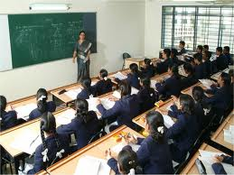

To Run the Package Properly
Classpath

Slide 14
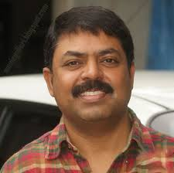
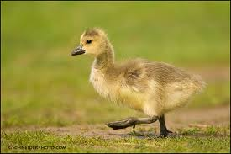
Sun Engineer
James Gosling

Slide 15
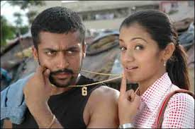
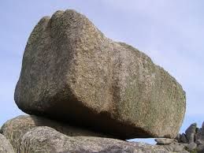
A Company Owned Java
Oracle

Slide 16

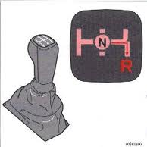
A Java Feature
Architecture Neutral

Slide 17
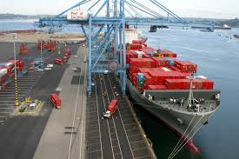
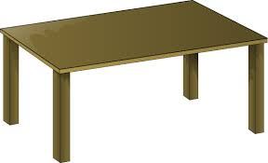
A Java Feature
Portable

Slide 18
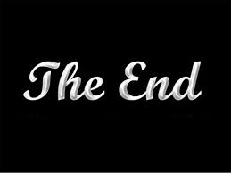

A Java Keyword
Final

Slide 19



A Method Type
Call by Reference

Slide 20

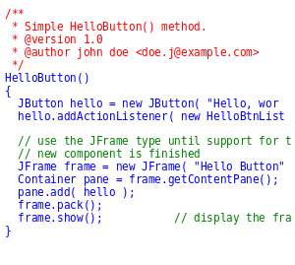
Used by the JVM
Bytecode

Slide 21


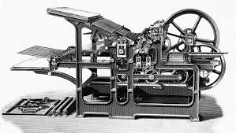
Used to Run the Bytecode
Java Virtual Machine

Slide 22

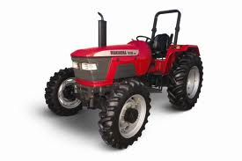
A Java Concept
Constructor

Slide 23
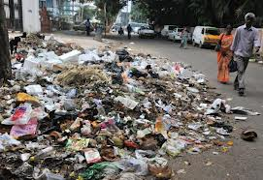
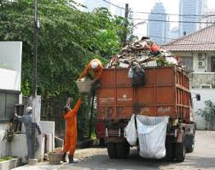
Automatically Reallocate Memory
Garbage Collection

Slide 24
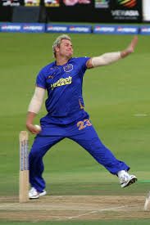


A Java Concept
Constructor Overloading

Slide 25
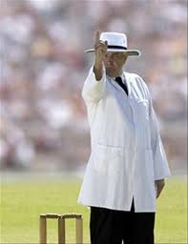
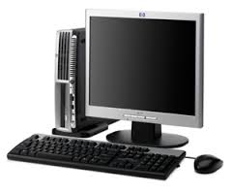
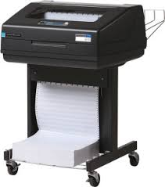
A Java Statement
System.out.println()

Slide 26


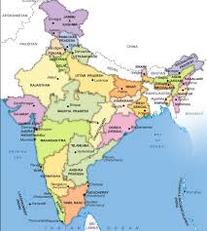
A String Process
Concatenation

Slide 27
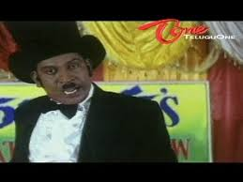

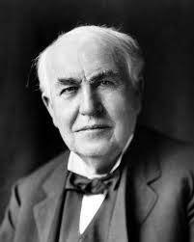
A Java Flavor
Java 2 Standard Edition

